Slide 1
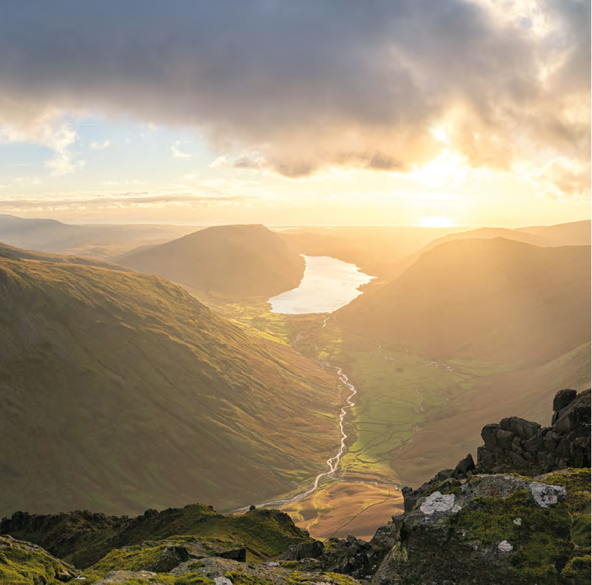
Welcome to the BCSSS Regional Meetings
November/December 2025

Slide 2
Update from the Trustees
Investment reserve transfer
Trustee Board Update
Our strong financial position
Investment update
Notes:
We’ll take questions after each section

Slide 3
The Government has agreed to transfer the investment reserve to members

Slide 4
What has the Government agreed to do?
On 26 November the Chancellor of the Exchequer announced:
  The transfer the whole of the £2.3 billion investment reserve to members.
The Government has also agreed that the Trustees can award members a new bonus pension equal to 41% of each member’s guaranteed pension
There is a commitment to review how any future surplus is shared.

Slide 5
Why has this happened?
      The Government has listened to the Trustees, Scheme members, and the MPs that have supported this campaign and agreed to treat the BCSSS in the same way as the MPS
      The Trustees would like to thank Scheme members for their support in helping raise this injustice with the Government

Slide 6
What did the Trustees do?
5
Meetings with the Minister for Industry in December, April, June, July and November to press for the transfer of the investment reserve.
+250
Briefing letters to key MPs, members of the House of Lords, members of the devolved administrations, key Select Committees, the Prime Minister, the Chief Secretary to the Treasury, etc.
43
Face-to-face meetings with individual MPs and groups of MPs to update them including, an event in Parliament attended by 50 MPs and their staff, and a meeting with the Coalfield Group of MPs.
22
Meetings around the country to support local MPs answer questions from the hundreds of members that have attended these events.

Slide 7
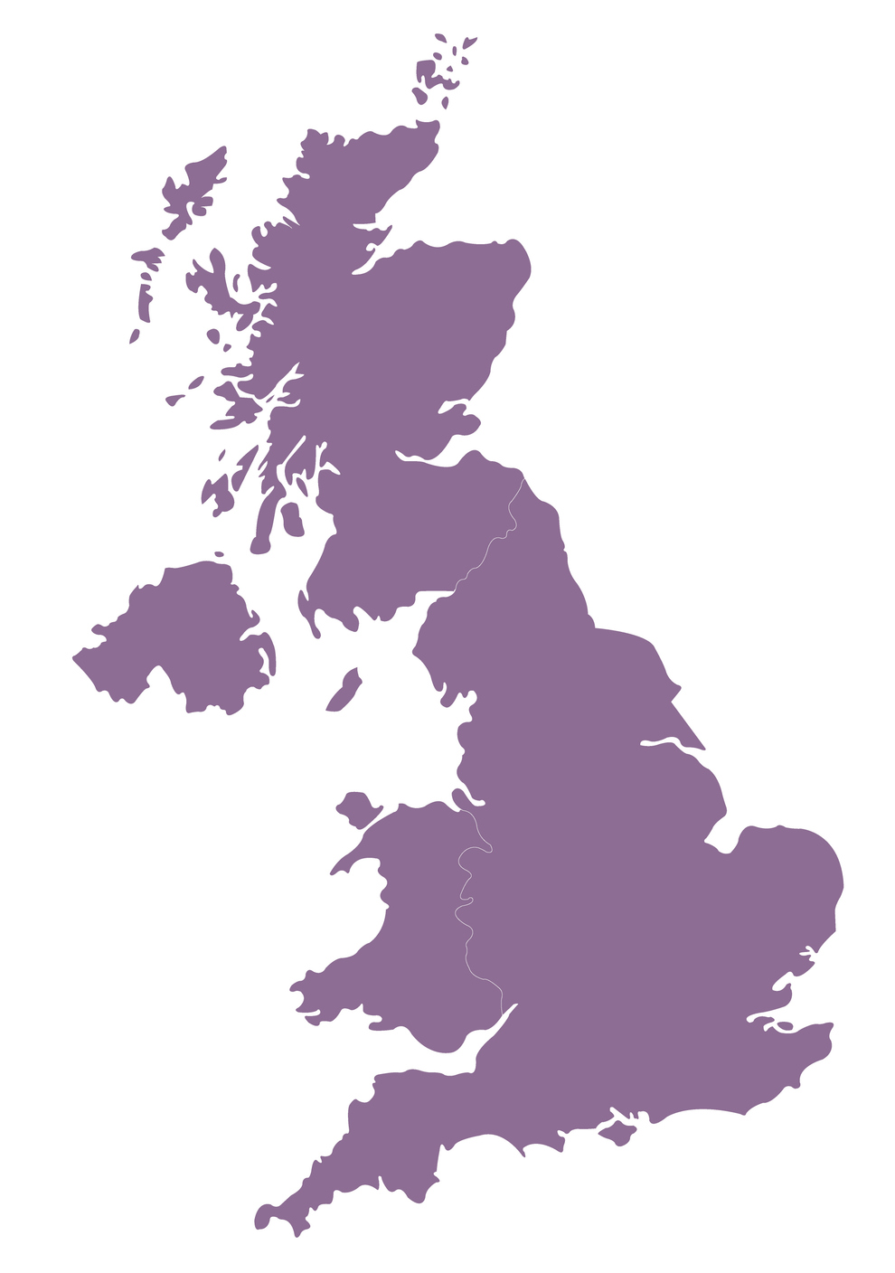
Who did they meet?
Supporting MPs and meeting members in:
Bassetlaw
Rawmarsh and Conisbrough
Caerfyrddin
Mansfield
North Warwickshire and Bedworth
Leigh and Atherton
North West Group of MPs
Rother Valley
North West Leicestershire
Sheffield South East
Bolsover
Blaydon and Consett
Tewkesbury
Caerphilly
Blaenau Gwent and Rhymney
Jarrow and Gateshead East
Chesterfield
North East Derbyshire
Barnsley North
Barnsley South
Newport West
Meeting Ministers and MPs in Westminster, including:
Five meetings with the Minister for Industry
Graham Morris the Chair of the Labour Group of Coalfield MPs
The Coalfield Group of MPs
A Group of 50 cross party MPs and members of the House of Lords who attended a ‘drop in’ session to find out about the investment reserve issue
John Healey the Secretary of State for Defence
Individual MPs, including: Steve Yemm, Allison Gardner, Michelle Welsh, Sally Jameson, Lee Pitcher, Jo White, Keir Mather, Lee Anderson, Nick Smith, Elaine Stewart, Stephanie Peacock

Slide 8
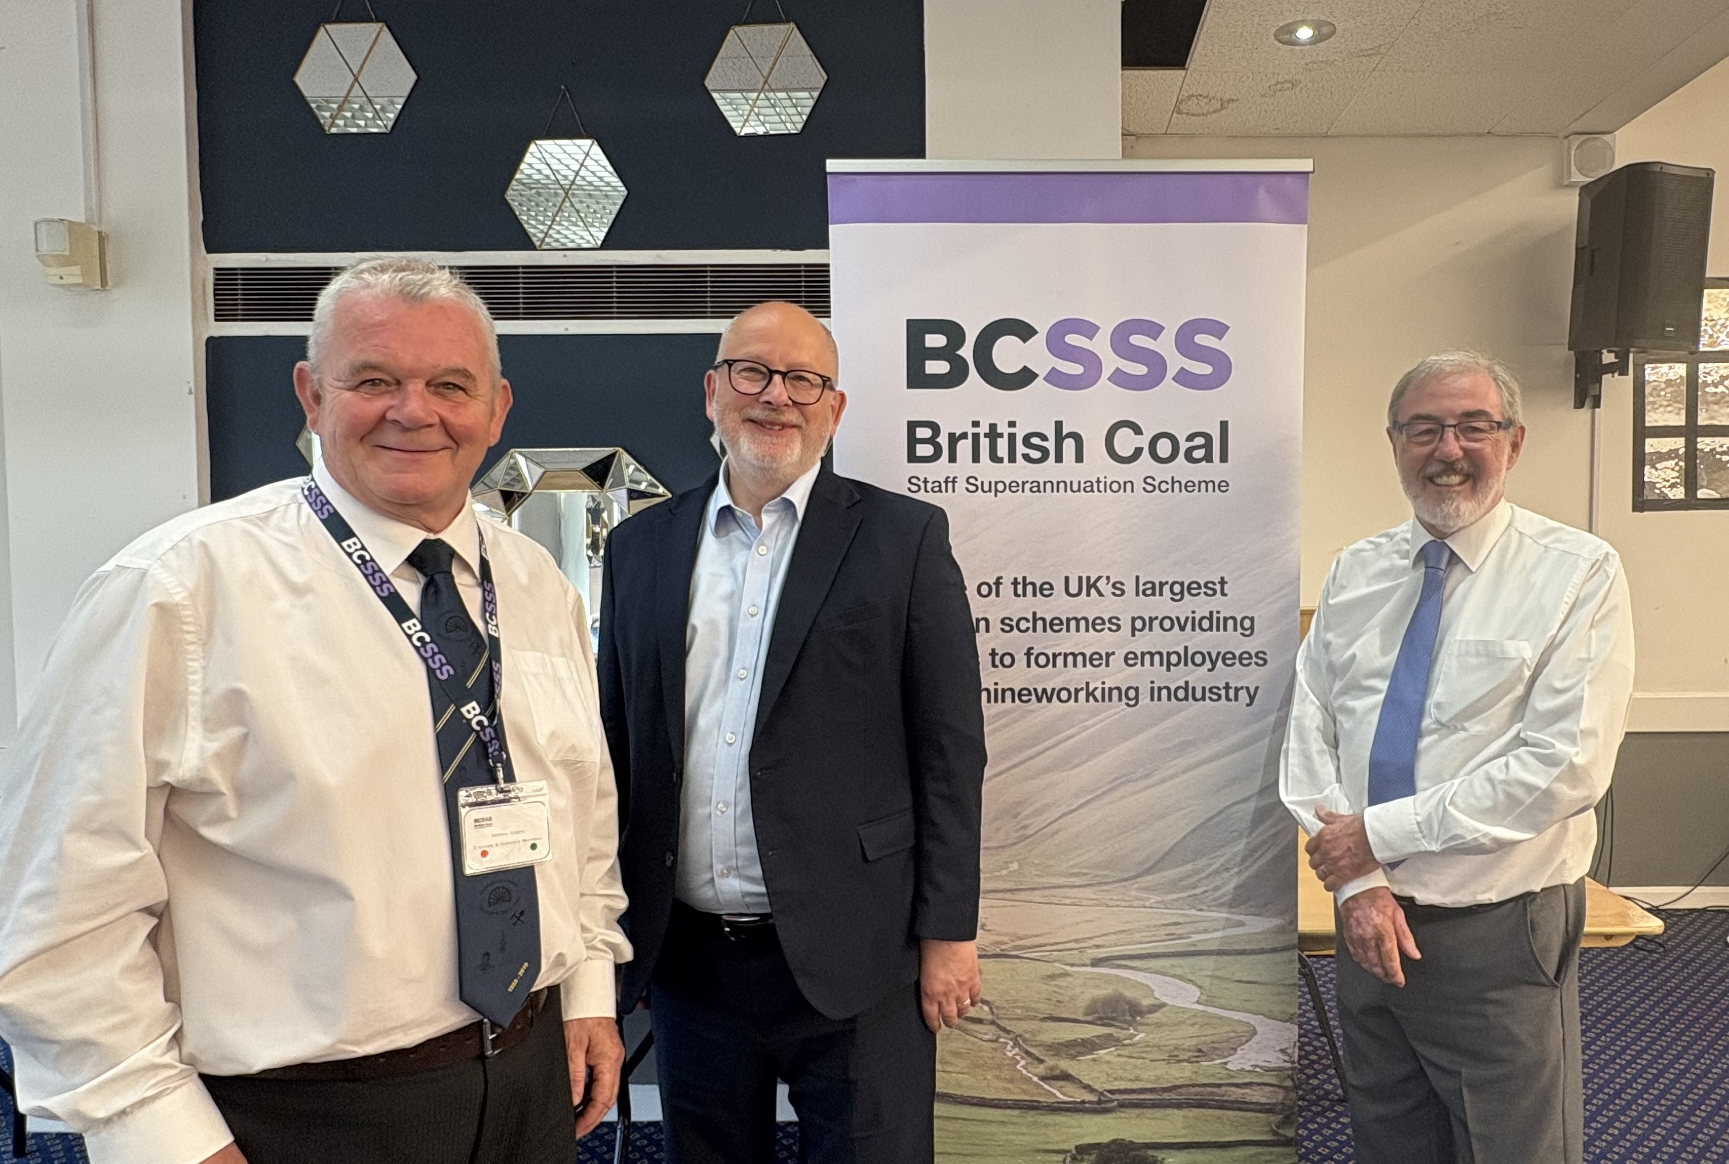
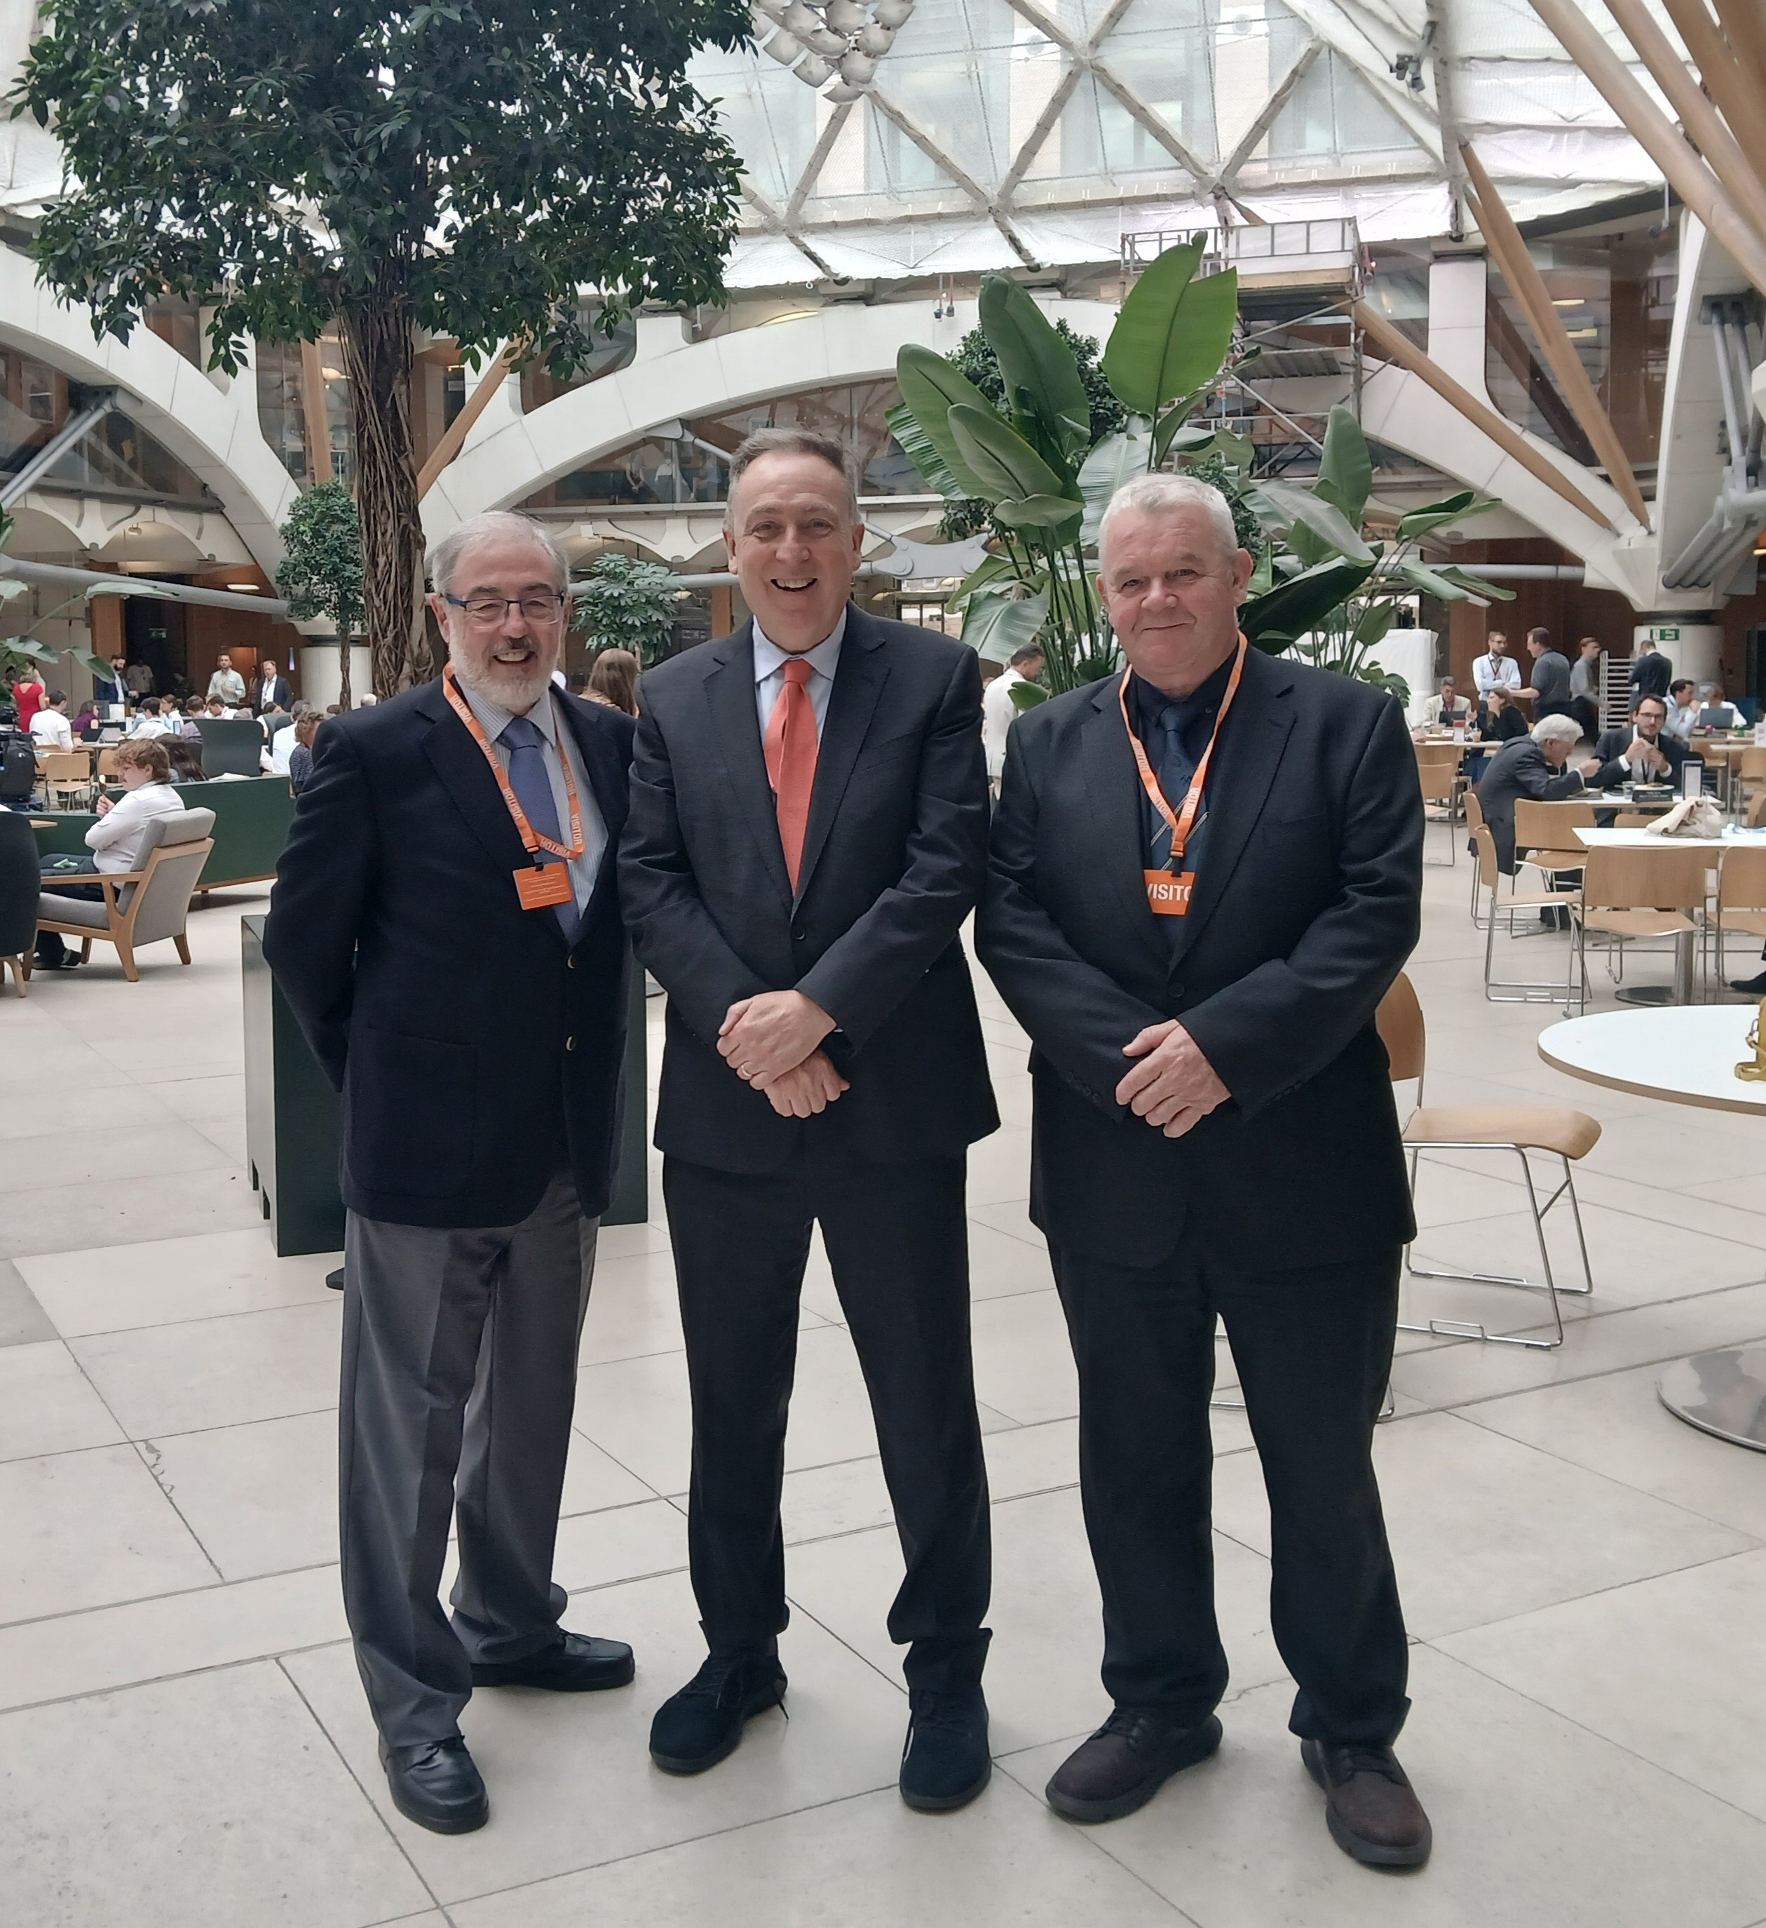
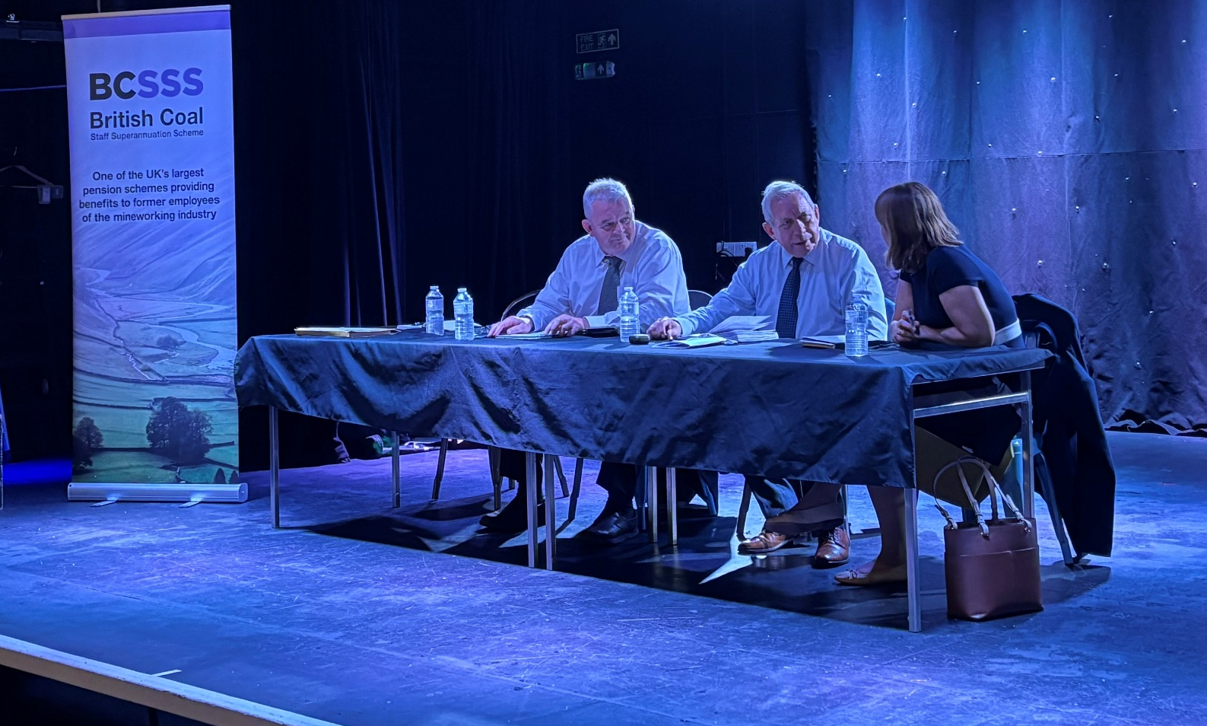
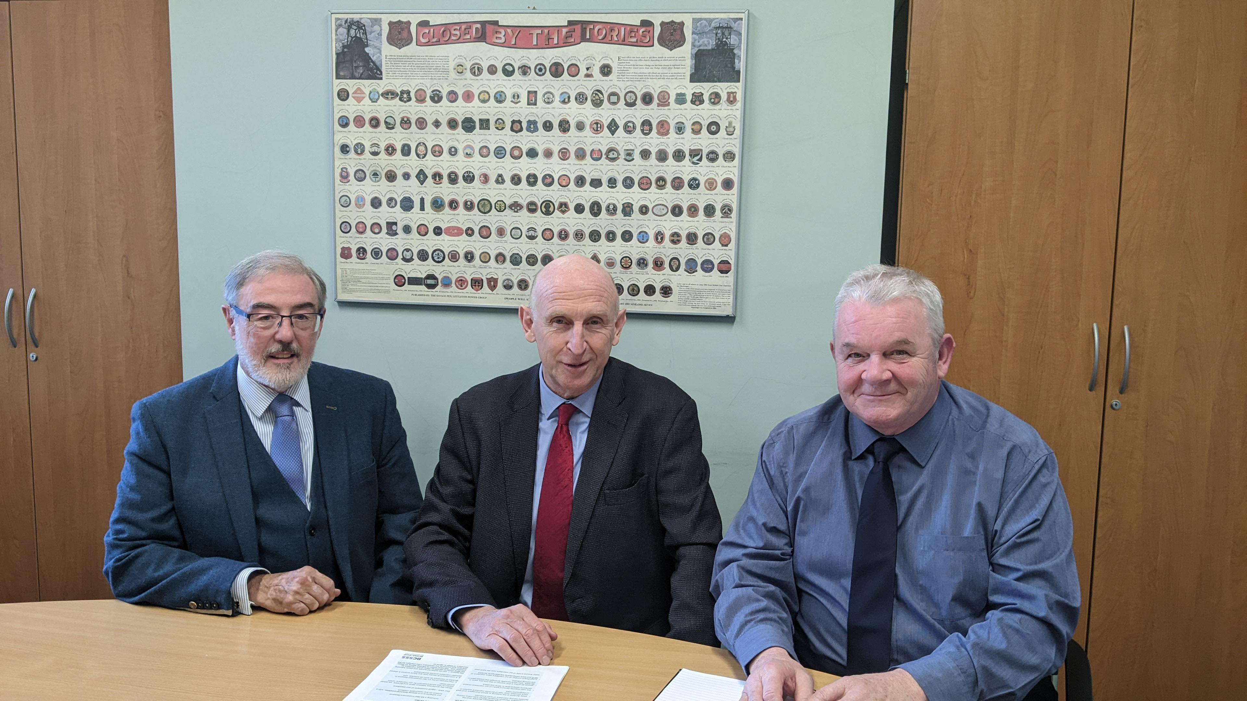
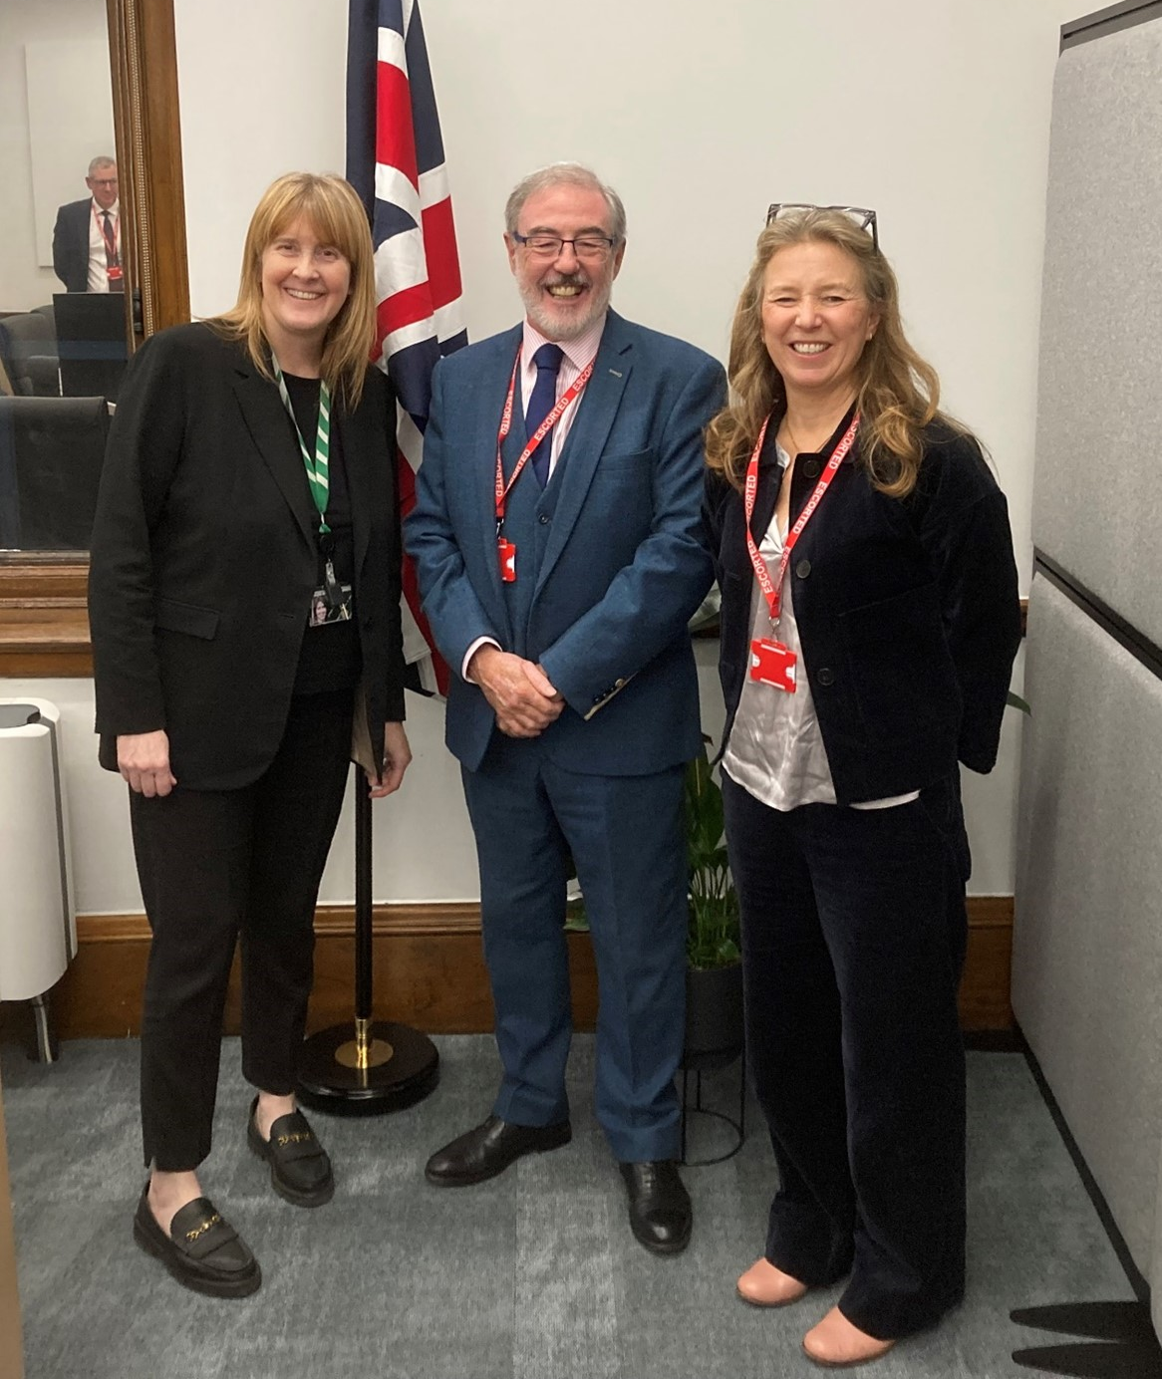
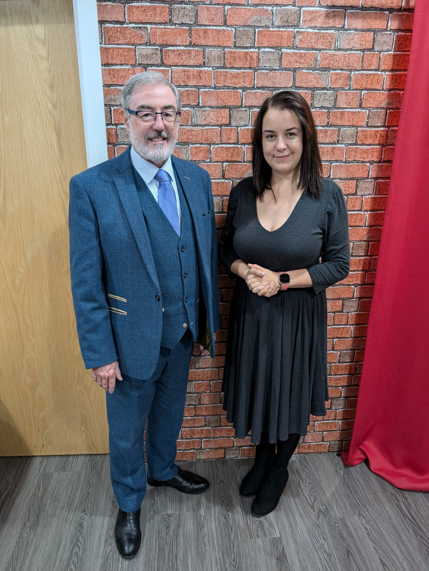
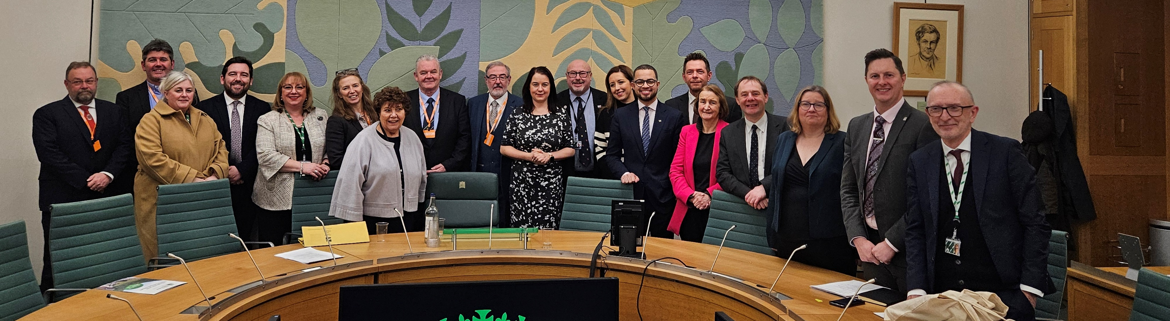
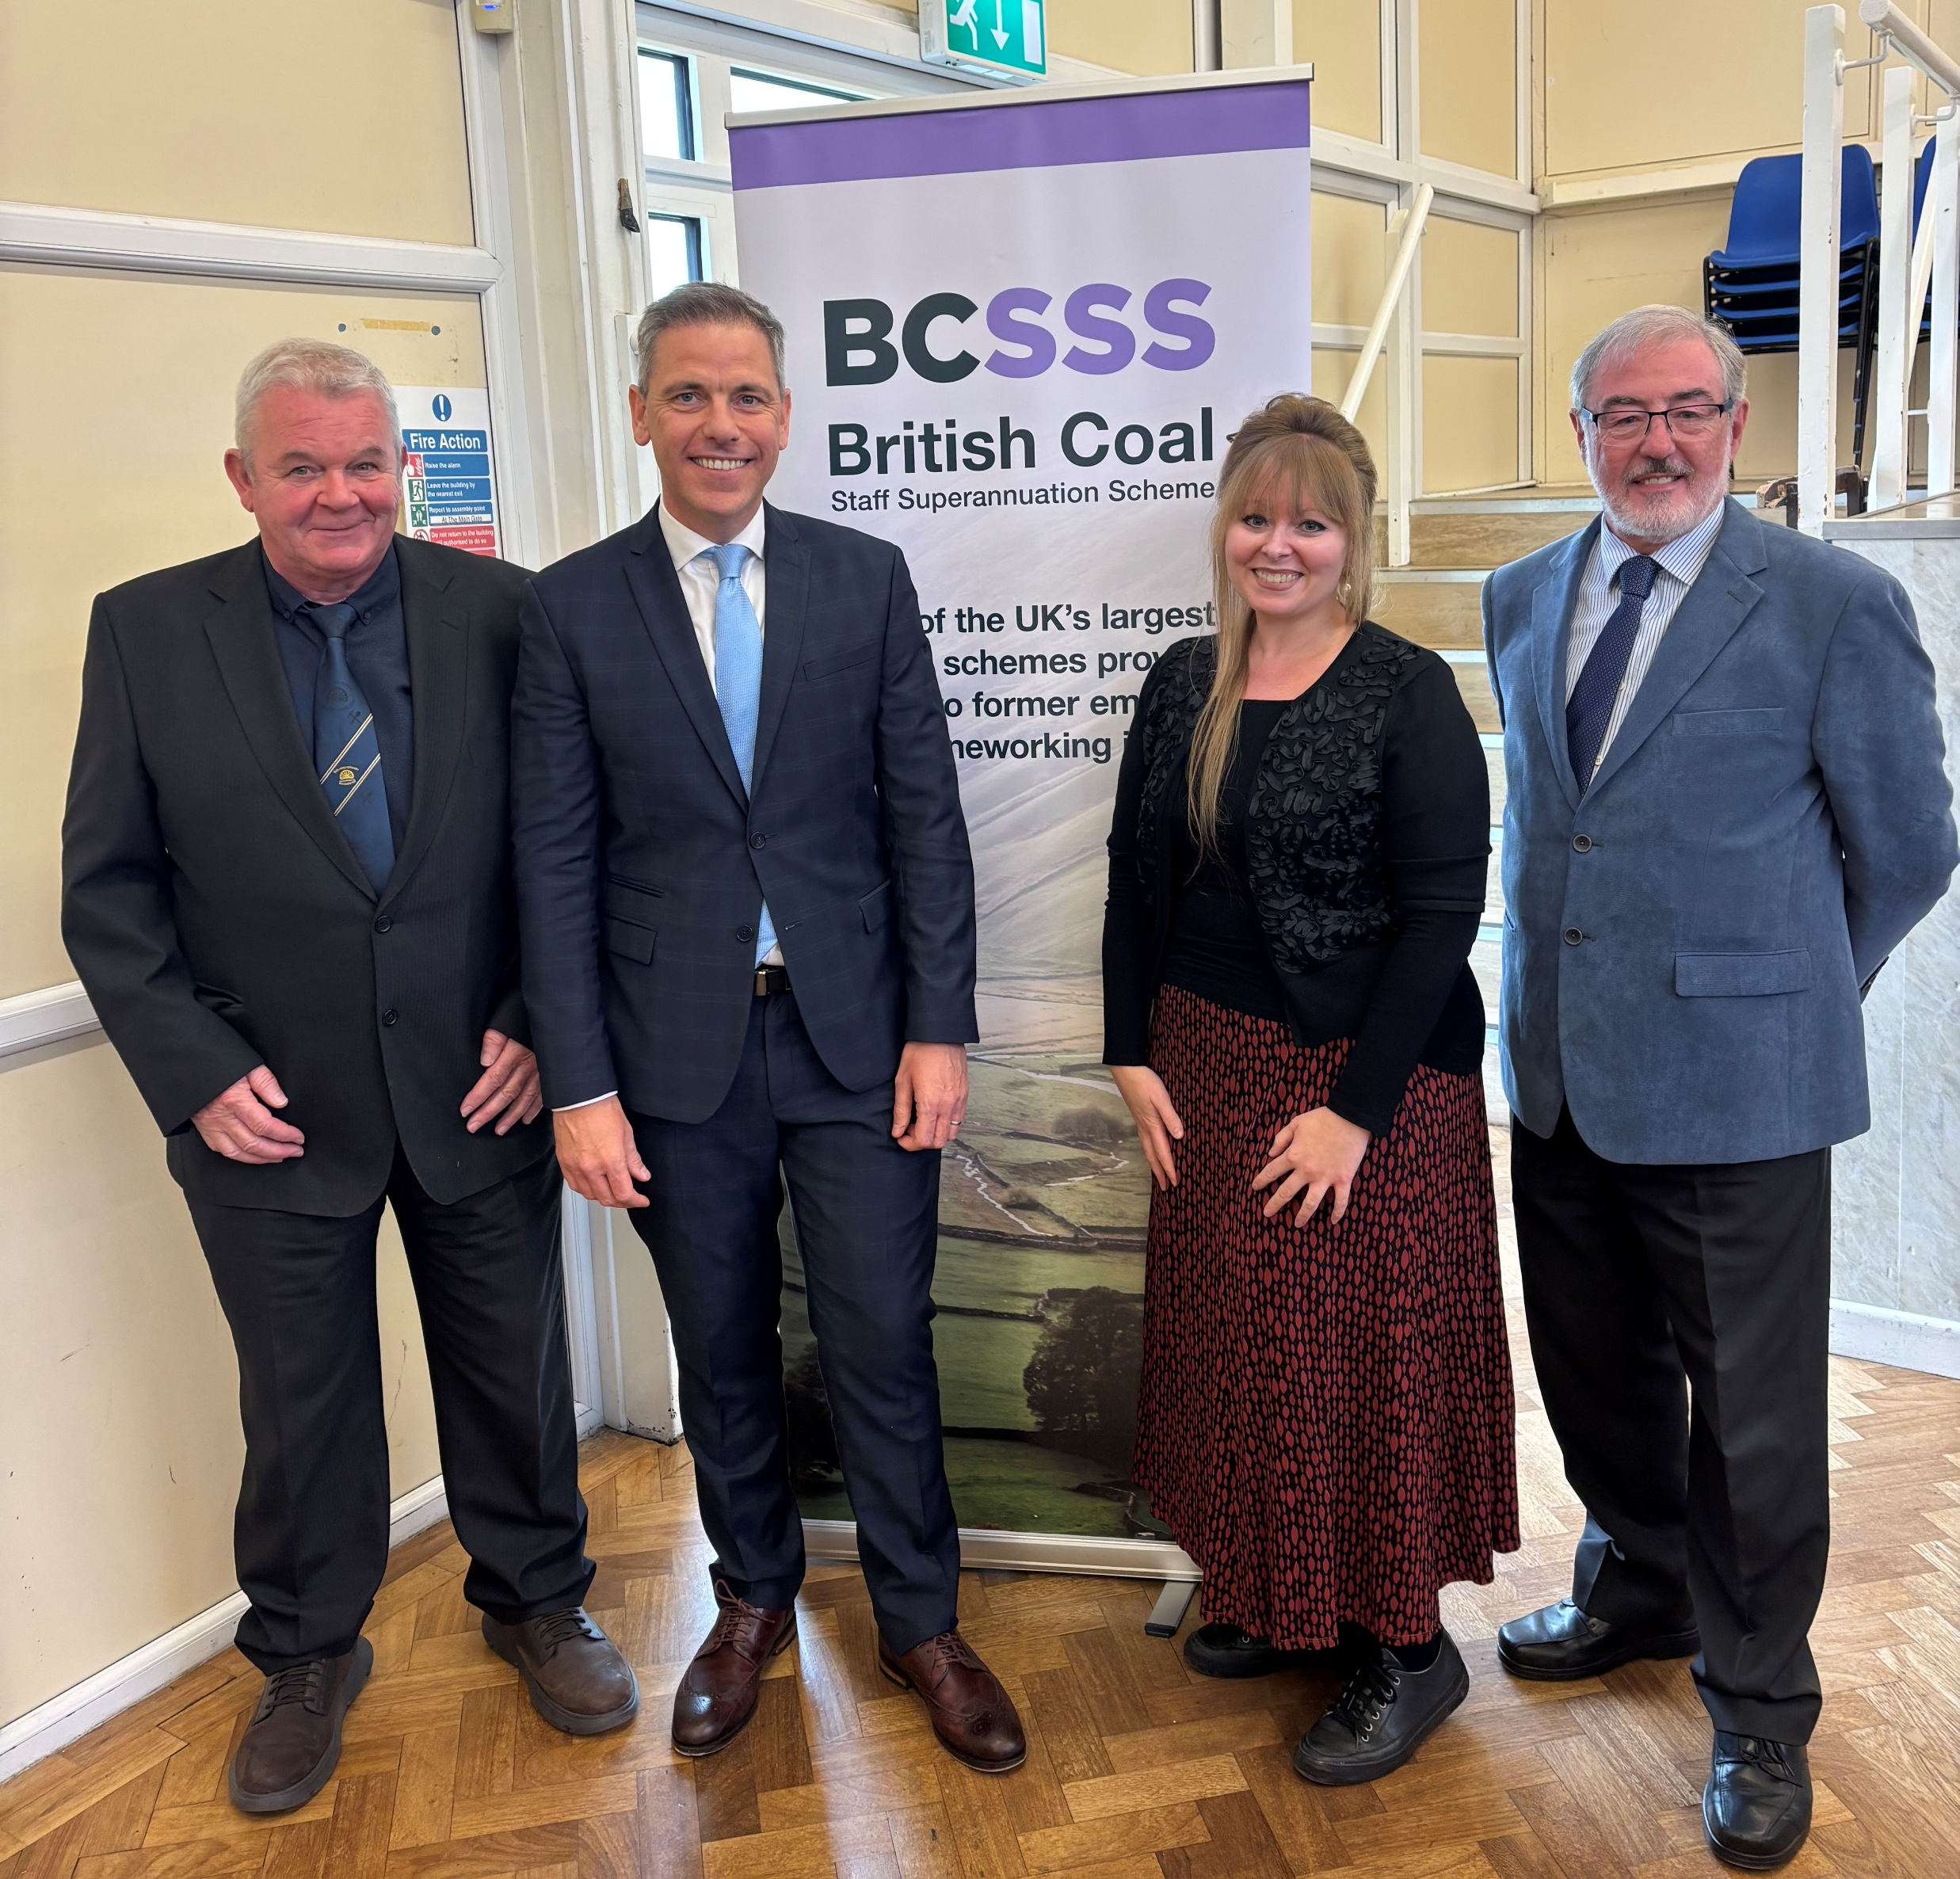
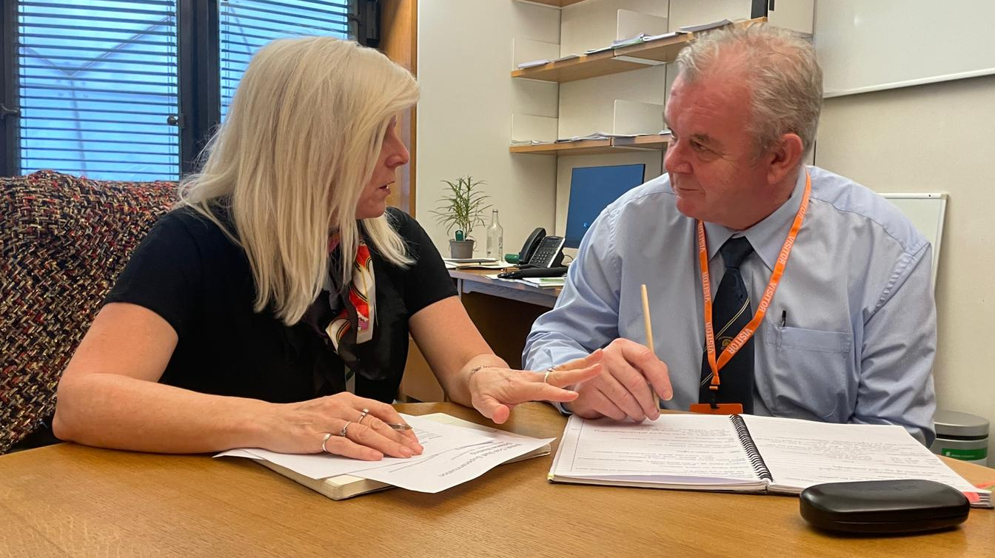
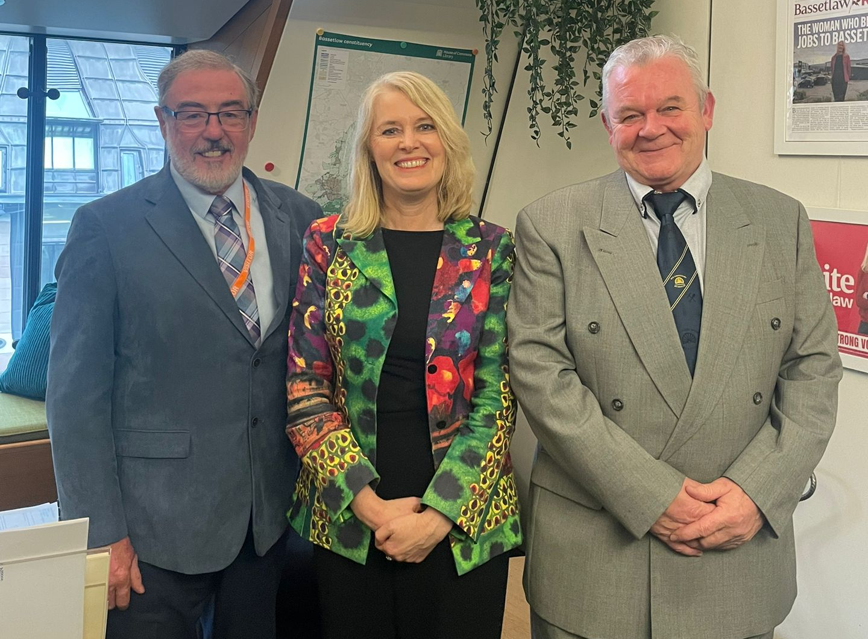
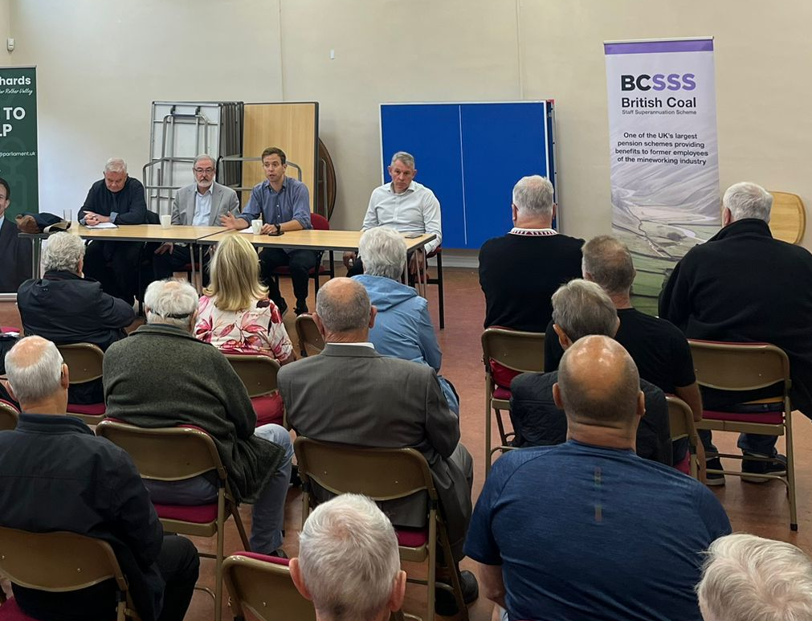
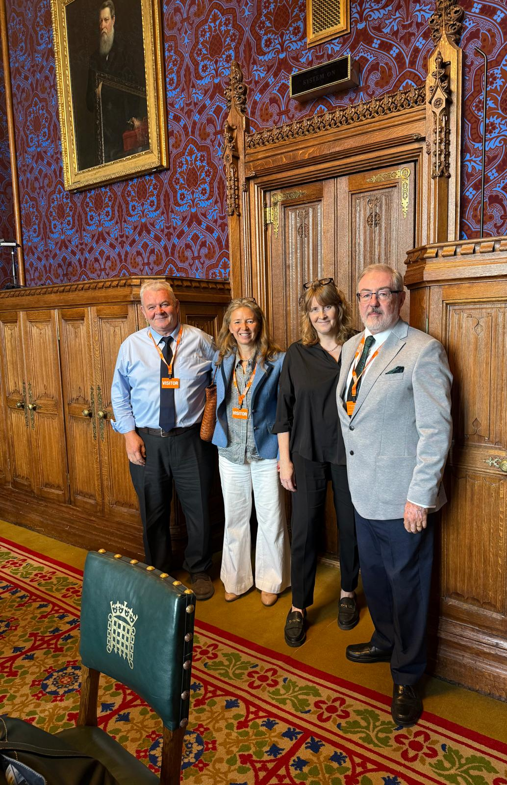
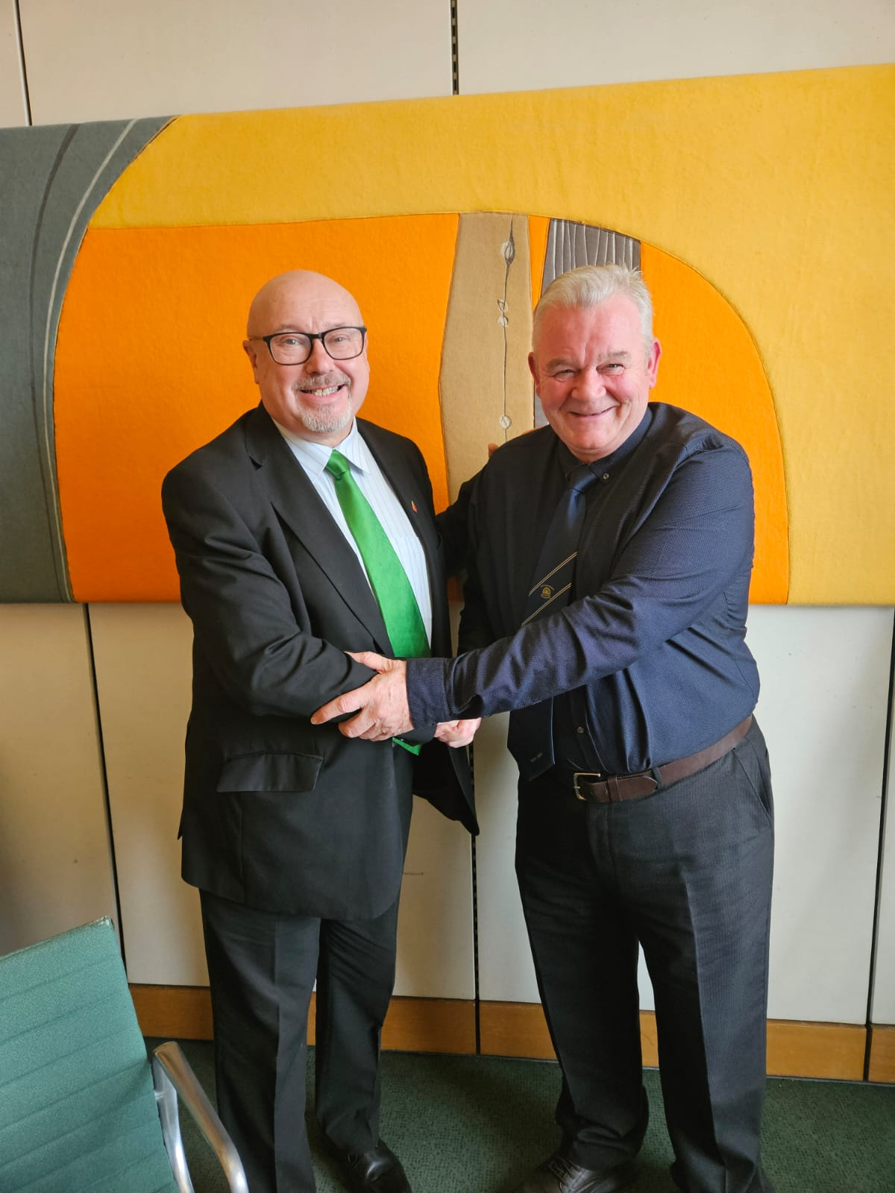
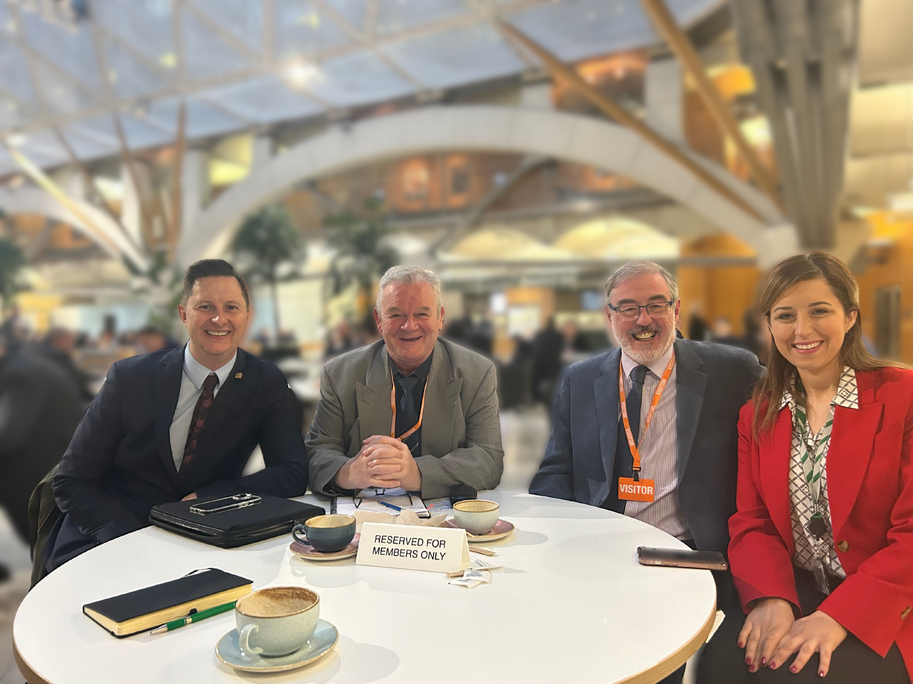
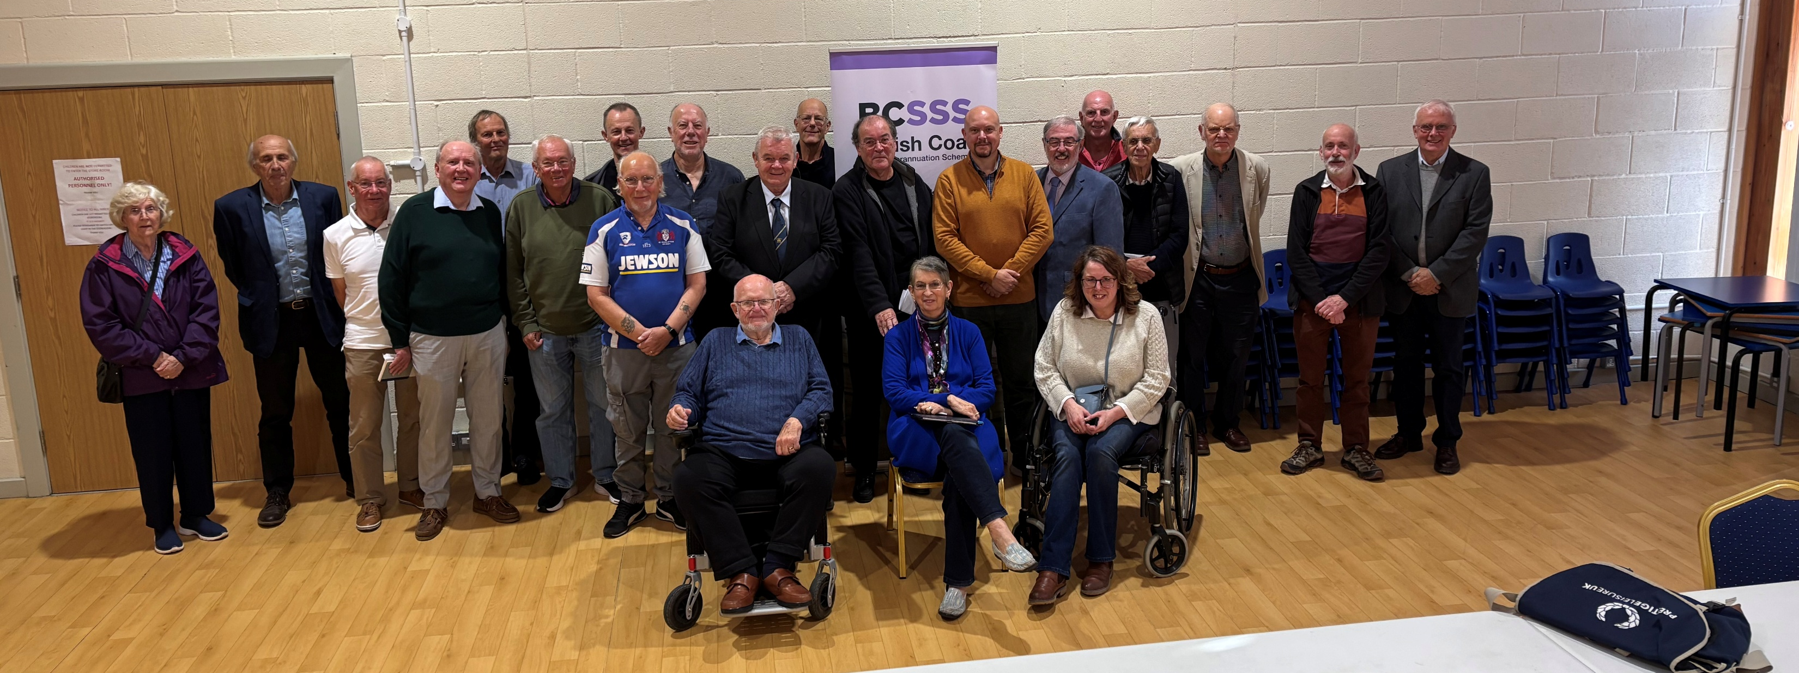
Just some of the MPs the trustees have met

Slide 9
How will pensions be increased?
      The new bonus pension will be calculated as 41% of your Guaranteed Pension at 1 November 2024
        this will be a flat non-increasing pension
        backdated to 1 November 2024
        if there is only an Estate left, we will make any backdated payment due to the Estate

Slide 10
When will the bonus pension be paid?
The Trustees only found out about the Government’s decision less than 24 hours before the budget announcement
However, we still hope to pay your increase on
23 December – this is not yet fully confirmed
Assuming we can process the payments in time for the
December payroll you will also receive a lump sum on 23 December in respect of the bonus pension you should have received since 1 November 2024

Slide 11
When will I receive more information?
We will send you the following information in the post in the coming weeks:
    This years’ newsletter providing more details on the transfer of the investment reserve
    If you have a pension in payment, an individual letter setting out how your pension will increase and the amount of your backdated lump sum
    If your pension is not in payment, a deferred statement showing your new deferred bonus pension in February 2026
  Please be patient - our priority is to ensure your new bonus pension and backdated lump sum is paid before Christmas

Slide 12
Trustee Board Update

Slide 13
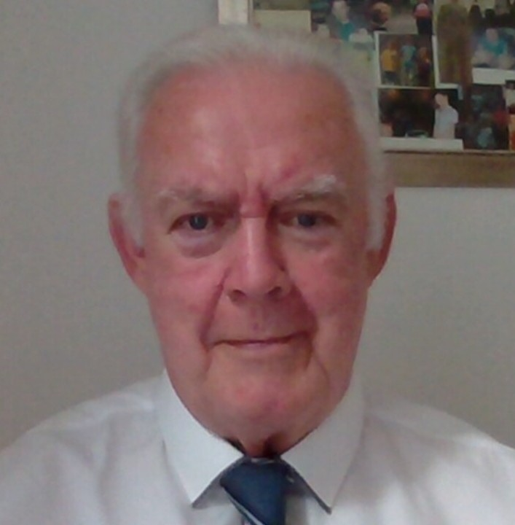
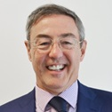
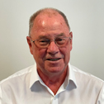
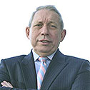
Your Elected Trustees
Mike Adie is the new Pensioner Representative for Scotland and North-East England.
Mike joined the Trustee Board on 10 November 2025. Welcome Mike!
Bleddyn Hancock is the Pensioner Representative Trustee for North West England, West Midlands, Wales and Northern Ireland. Bleddyn is a member of the Investment Sub-committee. Bleddyn was re-elected on 1 October 2024 and has now served as a trustee for just over 30 years.
John Owen is the Pensioner Representative Trustee for Yorkshire and North Lincolnshire. John is a member of the Administration and Benefits Sub-committee and the Discretions and Appeals Sub-committee. John was reelected on 1 October 2023 and has now served as a trustee for just over 3 years.
David Griffiths is the Pensioner Representative Trustee for the East Midlands, Southern England and Overseas. David is a member of the Investment Sub-committee and the Risk and Assurance Sub-committee. David was elected on 1 October 2022 and has now served as a trustee for 3 years.

Slide 14
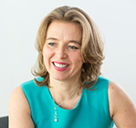
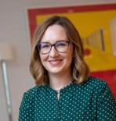
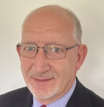
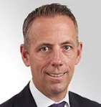
Your Appointed Trustees
Cheryl Agius is Chair of the Trustee Board, having been appointed on 21 September 2023. Cheryl has a financial services background and is also currently the Non-Executive Chair of the Board of Aviva Investments.
Eve Finn is Chair of the Investment Sub-committee, having been appointed on 1 June 2024. Eve has over 20 years’ experience across asset management, banking and investment consulting. Most recently, she was CEO of Legal & General Investment Management’s (LGIM) European Investment Management company.
Alastair Hadfield is Chair of the Administration and Benefits Sub-committee and Discretions and Appeals Sub-committee, having been appointed on 1 May 2025. Alastair was a Payroll, Project, and HR Manager in British Coal. He then held a number of senior appointments in the successor UK mining business, including Group Head of HR. He is also an employer nominated Trustee of the Industry Wide Staff Superannuation Scheme
Mike Eakins is Chair of the Risk and Assurance Sub-committee, having been appointed on 1 September 2024. Mike has over 25 years experience in asset management, banking and insurance. Mike is currently the Chief Investment Officer of the Phoenix Group plc, managing over £270bn of assets, on behalf of 12 million customers.

Slide 15
Our strong financial position

Slide 16
Strong financial position
      The Scheme has a strong financial position
      This was an important factor in the discussions with government about the investment reserve transfer
“The Scheme’s strong financial position is apparent in the analysis”
Government Actuary report to support investment reserve transfer May 2025
“I will not give figures, but the scheme is doing well. That is in part because of the trustees and the actions they have taken, and the investments and process they have undertaken.”
Minister for Industry, BCSSS debate, Parliament 11 June

Slide 17
Investment update

Slide 18
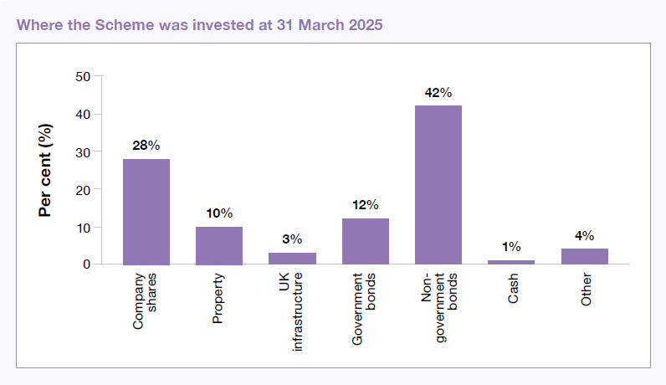
BCSSS Investments
Assets are around £8bn in total
Our focus this year has been on maintaining the Scheme’s strong financial position
We’ve invested in assets that better match factors like interest rates and inflation
We have prepared the assets for the transfer of the investment reserve and higher annual pension payments
Income paying assets
Periods to 31 March 2025 | Scheme return %
1 year | 1.1
3 years | 1.2
5 years | 28.2
Long-term, our assets have returned around 7% a year

Slide 19
Time for your questions
Questions?

